Slide 1

Voice Interaction for on-the-job Assistance
Making a Field Engineer’s life easier

Slide 2
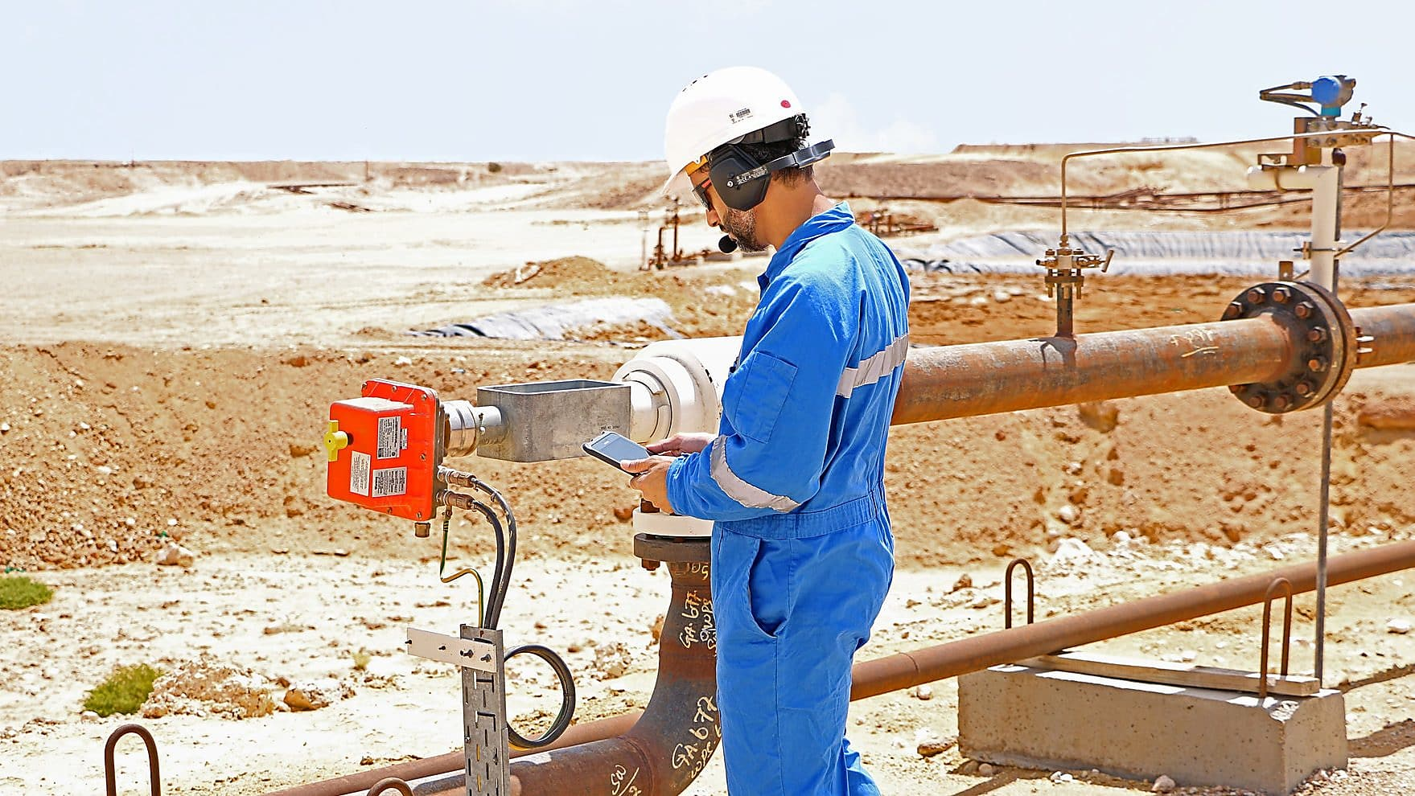
... How may I help you?

Slide 3
The Idea
Alexa for Field Engineers.
Step 3
Step 2
1. Extract the required information
2. Record tool readings & Schedule maintenance
Step 1
Select an operation to perform with Context
Tool Identification

Slide 4





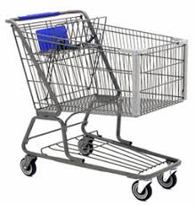
Features
Context based info
Readings & checklists
Location based info
Scheduling maintenance
Ordering equipment
Step-by-step guidance

Slide 5
Value Proposition
Improves Efficiency
On-the-job training
Probability of accidents & errors
Transparency in Real-time

Slide 6
How does it work?
Let’s see a Demo.

Slide 7


